Slide 1
Introduction to Angular 4

Slide 2
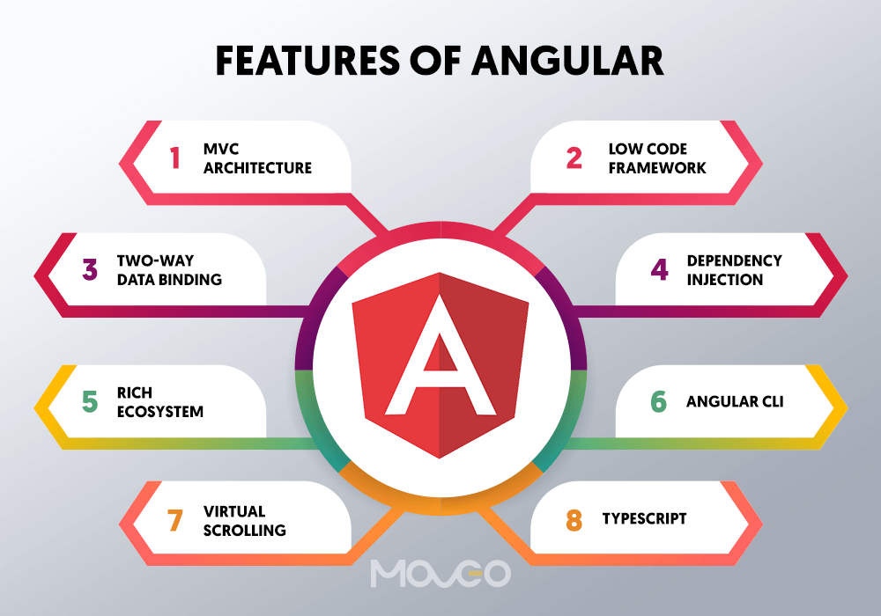
What is Angular?
Definition and overview of Angular framework. Key features and benefits of using Angular. Comparison with other frontend frameworks.

Slide 3
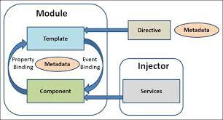
Angular Architecture
Understanding components, modules, services, and templates. Introduction to data binding and dependency injection. Overview of Angular's component-based architecture.

Slide 4
Prerequisites
Setting Up Angular Development Environment
NodeJs - install nodejs, go the homepage https://nodejs.org/en/download/ of nodejs and install the package based on your OS.
Use node -v to check version
Npm
Once nodejs is installed, npm will also get installed along with it.
Use npm -v to check version
Angular CLI
npm install –g @angular/cli
IDE for writing your code
WebStorm, Atom https://www.jetbrains.com/webstorm/download/

Slide 5
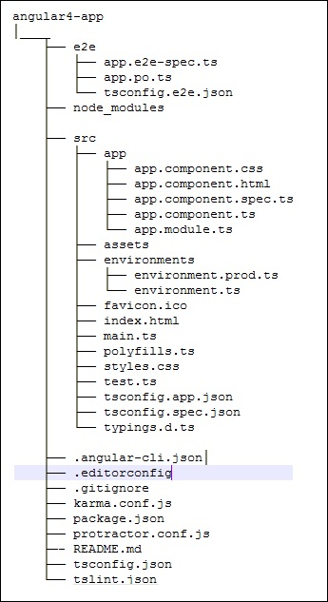
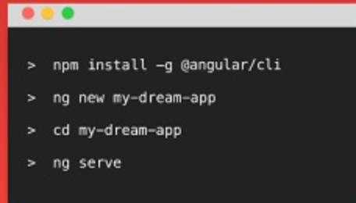
Creating a New Angular Project
Using Angular CLI to create a new project.
ng new helloWorld
Basic project structure and files.
Angular4 uses TypeScript 2.2 version

Slide 6
Running the Application
Using Angular CLI commands to run the application.
ng serve Viewing the application in a browser.
http://localhost:4200/
Major part of the development with Angular 4 is done in the components. Components are basically classes that interact with the .html file of the component, which gets displayed on the browser. The file structure has the app component and it consists of the following files −
app.component.css
app.component.html
app.component.spec.ts
app.component.ts
app.module.ts

Slide 7
Components
Creating and defining components. Anatomy of a component: class, template, and metadata. Using the `@Component` decorator.
Example which shows a login form with input as username and password. Upon entering the correct values, it will enter inside and show another form wherein, you can enter the customer details. In addition, we have created four components - header, footer, userlogin and mainpage.
ng g component header
ng g component footer
ng g component userlogin
ng g component mainpage
Follow : https://www.tutorialspoint.com/angular4/angular4_examples.htm

Slide 8
Templates and Data Binding
Creating templates with HTML and Angular syntax. Understanding data binding: interpolation, property binding, event binding, two-way binding.

Slide 9
Directives
Built-in directives like `*ngIf` and `*ngFor`. Creating custom directives.

Slide 10
Services and Dependency Injection
Introduction to services and their purpose. Creating and using services. Injecting services into components.

Slide 11
Dependency Injection
Understanding dependency injection in Angular. Registering and providing dependencies.

Slide 12
Routing and Navigation
Setting Up Routes
Configuring routes in Angular. Using the `RouterModule` and `Routes` configuration.

Slide 13
Navigation
Creating navigation links using the `routerLink` directive. Navigating programmatically using the `Router` service.

Slide 14
Route Parameters
Passing parameters to routes. Retrieving route parameters using `ActivatedRoute`.

Slide 15
Template-driven Forms
Creating forms using Angular's template-driven approach. Binding form controls to component properties.

Slide 16
Angular's HttpClient
Overview of Angular's `HttpClient` for making HTTP requests. Configuring headers and options.

Slide 17
Fetching Data
Using `HttpClient` to fetch data from a RESTful API. Handling asynchronous operations with Observables.

Slide 18
References
https://www.tutorialspoint.com/angular4/index.htm

